Slide 1


Car assistant system for road lanes and traffic signs detection
Final presentation
Shreetal Upadhyay
shreetal.upadhyay@fs.cvut.cz
Supervisor : Ing. Jaroslav Busek, Ph.D.
4 February 2020

Slide 2
Purpose
Traffic Sign Classification Using GTSRB Datasets
Lane Detection
Simulation In Udacity Environment

Slide 3
Methods
Traffic Sign Classification
Inputs (GTSRB)
LeNet Model
Lane Detection
Canny Edge Detection
Region of Interest
Hough Transform
Simulation in Udacity Environment
Data Adjustment
Image Preprocessing
Nvidia Model Implementation
Data Augmentation

Slide 4
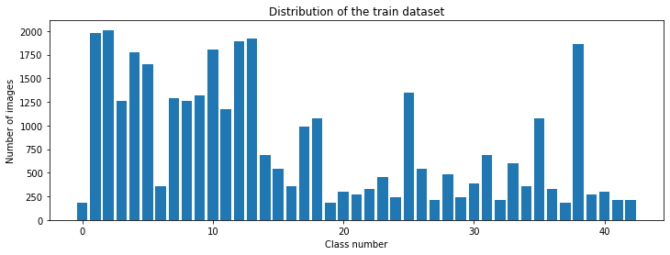
Statistical Analysis
Total no of classes-43 (X-axis)
No of Training Images-34799 (Y -axis)

Slide 5
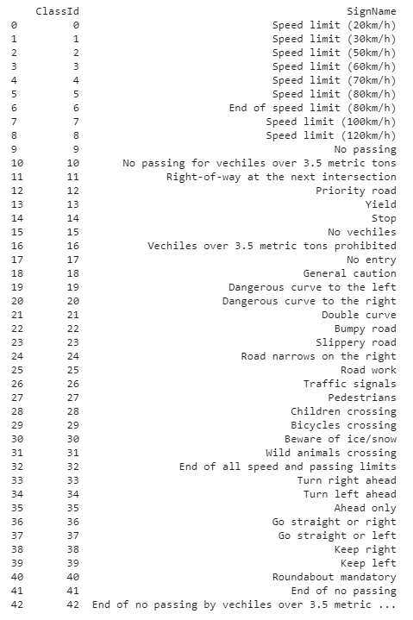

Slide 6
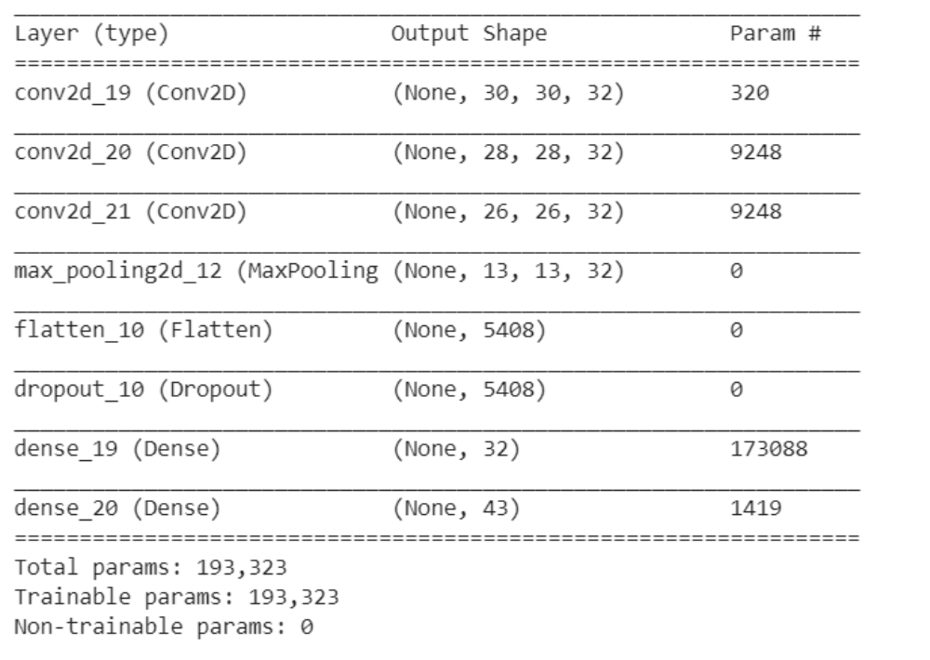
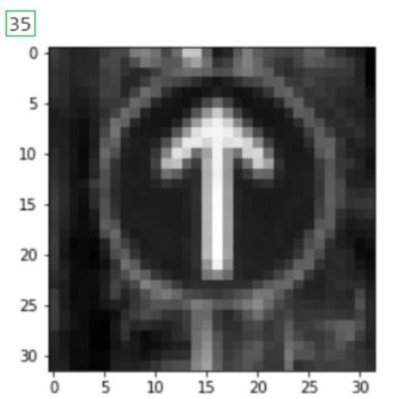
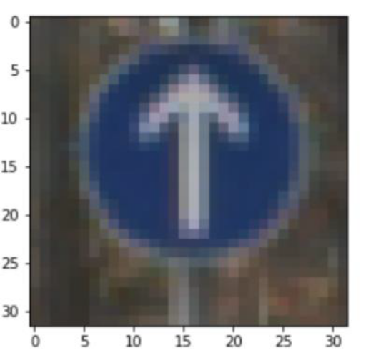
Results
Traffic Sign Classification
Original Image
Preprocessed Image
Original Image with size 32 x 32 x 3
Preprocessed Image size 32 x 32 x 1
LeNet Model

Slide 7
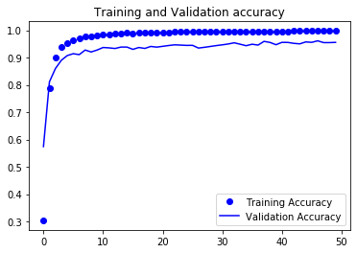
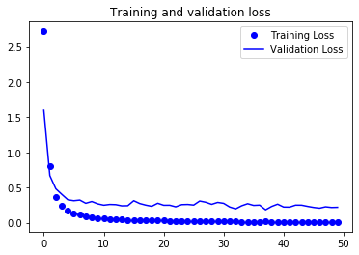
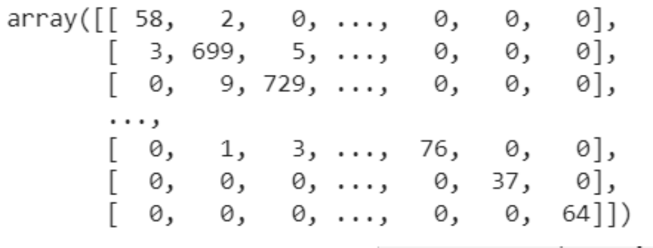
Model Tuning
Confusion Matrix

Slide 8
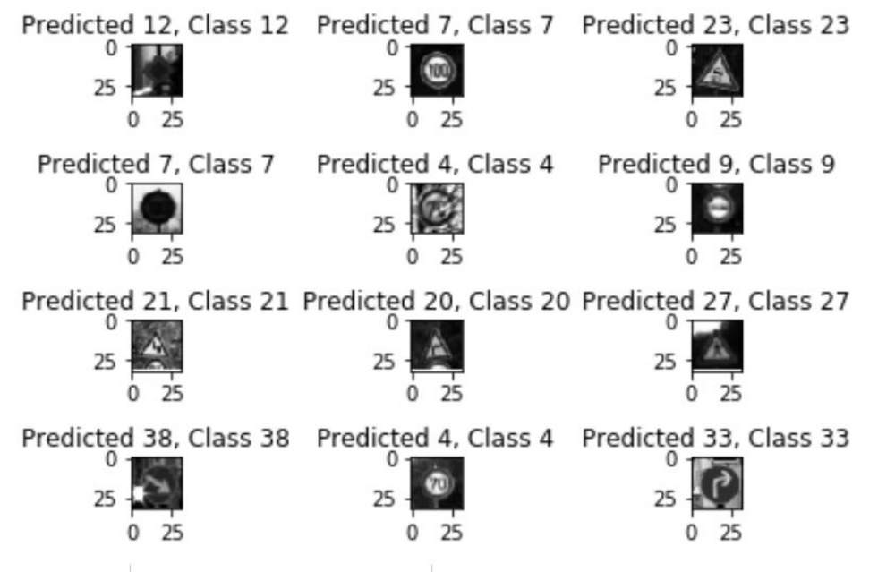
Test Output

Slide 9
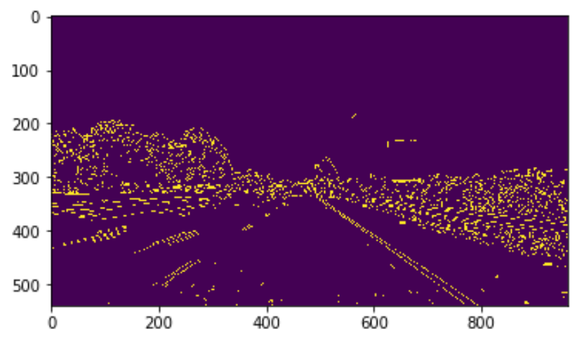
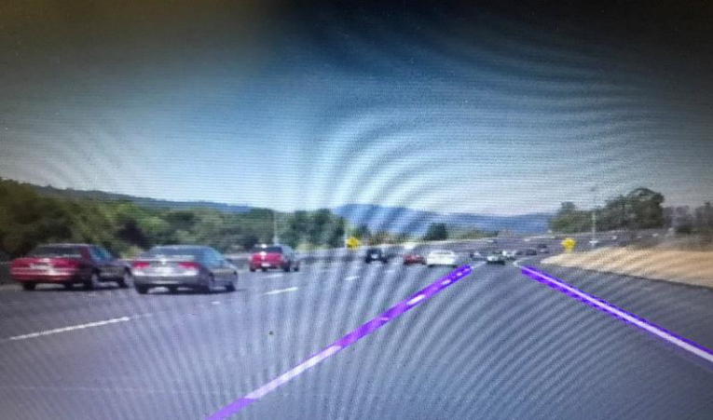
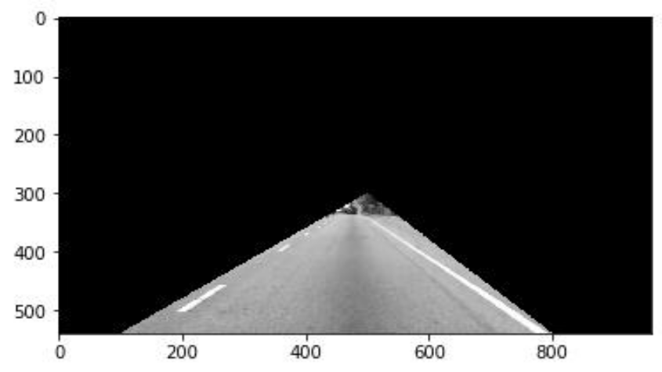
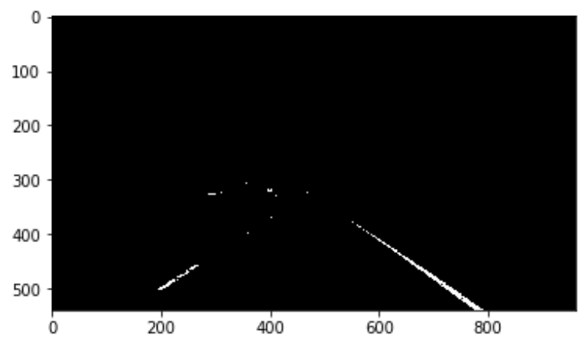
Lane Detection
Canny Edge Detection
Hough Transform
Region of Interest
Lane Line Detected in video
Image after bitwise Operation

Slide 10
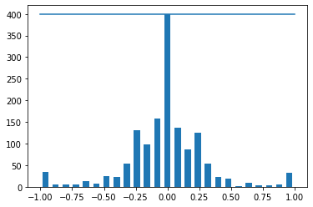
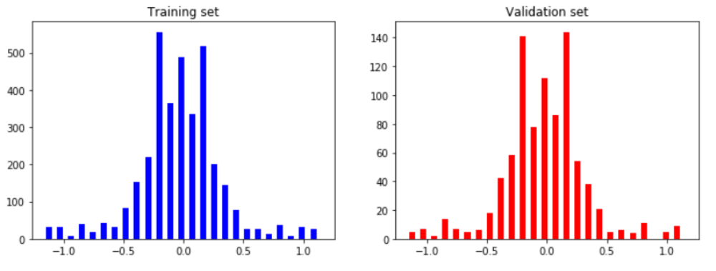
Simulation In Udacity Environment
Data Adjustment
Data Splitting in to Training set and Validation
Histogram of Training data
X-axis- Steering angle
Y-Axis- Histogram values

Slide 11
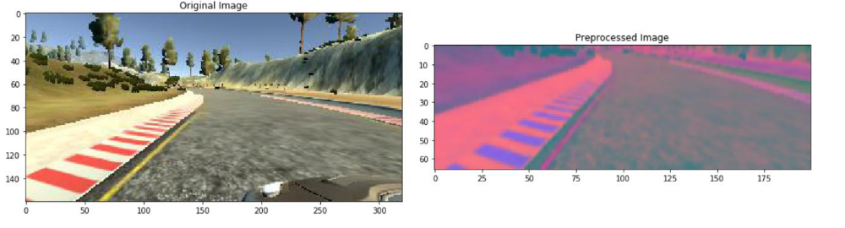
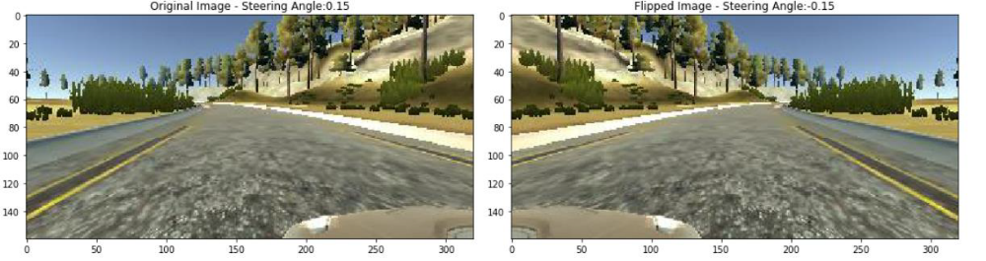
Image Preprocessing
Data Augmentation

Slide 12
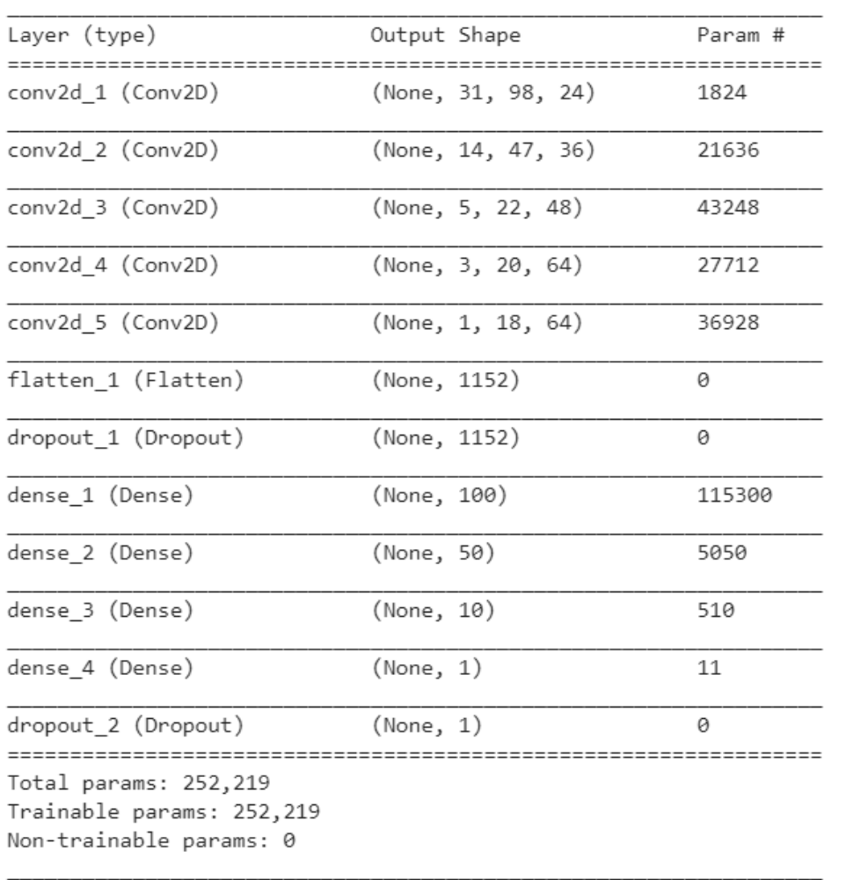
Nvidia Model

Slide 13
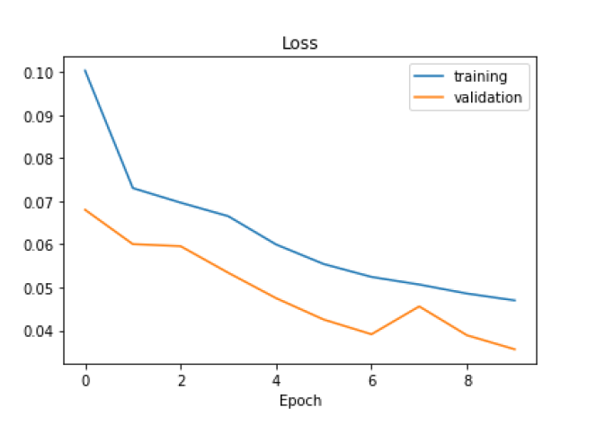
Fit generator
Loss value for Training and Validation

Slide 14
Conclusion
In Traffic Signs Classification LeNet model with several convolutional networks with different depth and type of layers were trained . One model was chosen after training it several times.
In detecting ,OpenCV library and its functions such as the Canny Function through which we achieved edge detection. Then we prepared a mask of zero intensity and mapped our region of interest by performing the bitwise operation. Then the Hough Transform technique was use which detected the straight lines in the image and identified the lane lines.
For the Simulation in Udacity environment
Collecting high quality and quantity real world data on the road is bit difficult, and being able to train these models in a simulator with seemingly infinite data could provide a significant breakthrough in autonomous driving. As seen in this task, even with a relatively small amount of data and fairly simply CNN model, the vehicle was able to steer successfully autonomously through both courses.

Slide 15
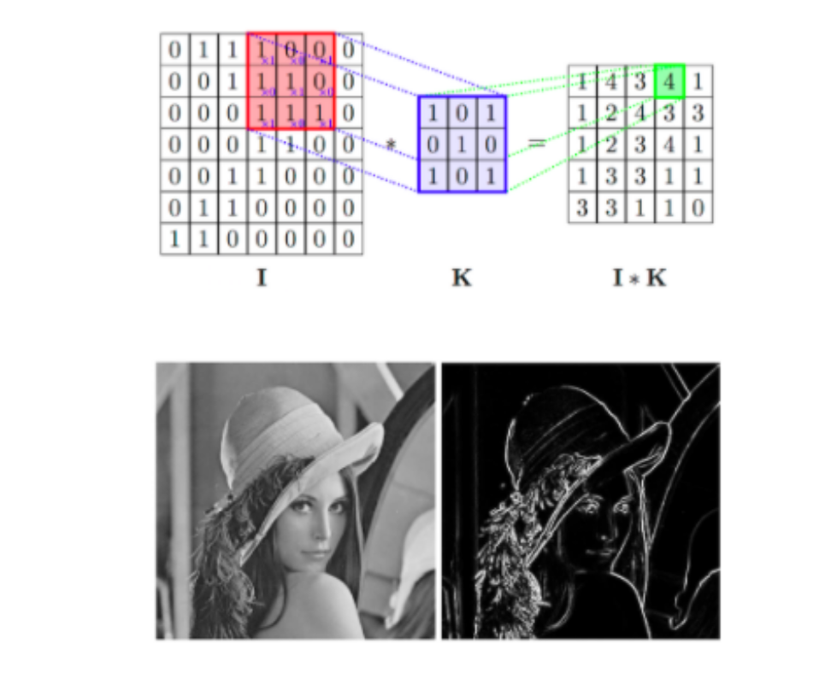
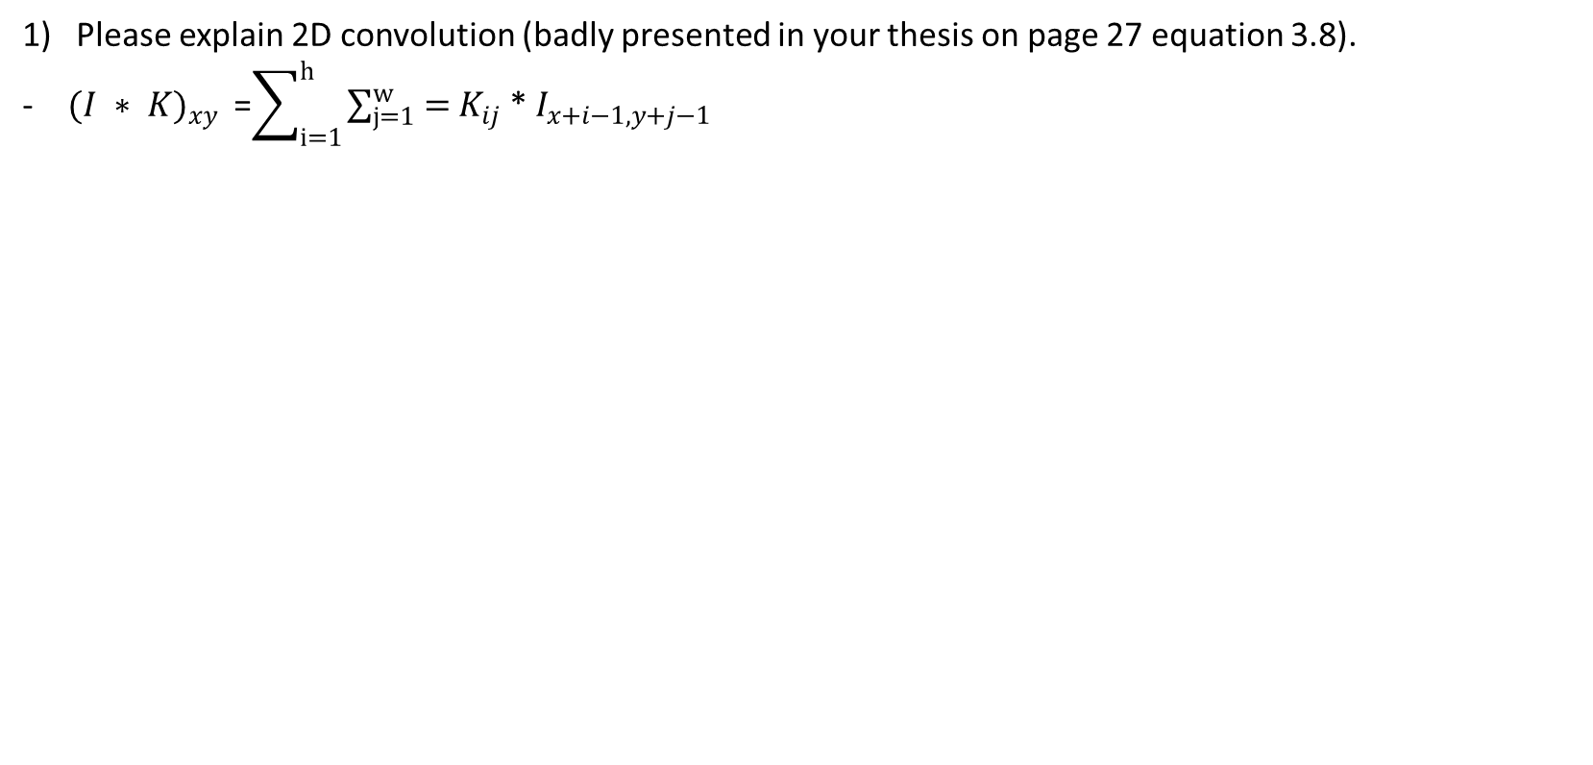
Questions from the reviewers
Please explain 2D convolution (badly presented in your thesis on page 27 equation 3.8).
${(I ∗ K)}_{xy }$ =$\sum_{i=1}^{h}{\sum_{j=1}^{w}{=}}$ $K_{ij}$ * $I_{x+i−1,y+j−1}$

Slide 16
2) In your models (both NVIDIA and LeNet) you are using several 2D convolutional layers but only one maxpooling layer. What is the purpose of maxpooling layer? How many training parameters maxpooling layer have? Why did you use only one in your models?
-Maximum pooling layer calculates the largest number from each feature map.
-Zero Training parameters in Max pooling Layers
-I feel one pooling layer was good for the experiment
3) Explain difference between training, validation and testing dataset?
-Training Data set is used for weight adjustment in neural networks
-Validation data set is used to overcome overfitting.
-Testing set is used for the final output and to see the actual predictive analysis of the network
4) Why did you choose python?
-Most demanding language.
-Easy to understand compare to other Programming Languages.
-Wanted to become a Pro and develop my career for the same.

